Slide 1
The Effects of Competition on Corporate Sustainability
Titing Cui, Esther Gal-Or, Mike M. Gordon,
Michael L. Hamilton and Jennifer Shang

Slide 2
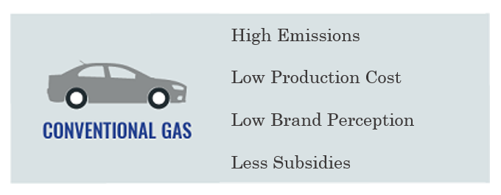
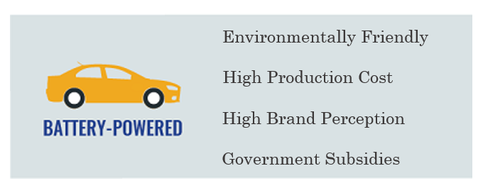
Green Production
Environmentally sustainably green products are often preferred by customers and society but are more costly to produce.
Example:
EVs operate at a substantially lower environmental impact per mile driven on carbon emissions but are more expensive to manufacture.
ICVs are not as eco-friendly as their electric cousins, economies of scale and decades of innovation have driven down their production costs
Notes:
Hint: what is green production?

Slide 3
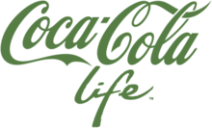
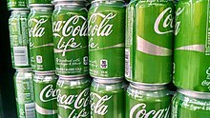
Corporate Social Responsibility
A firm can improve its reputation among customers in a competitive market without necessarily greening its manufacturing processes.
Consider the Halo Effect (Jin and Lee, 2019)
A public display of social investment is often used to cover up less visible non-green practices (greenwashing).
Notes:
Hint: what is CSR?

Slide 4
Market Competition
“The monopolist is the conservationist’s friend” (Hotelling, 1929; Solow, 1974).
Literature:
(Duanmu et al.,2018) use a large sample of Chinese manufacturing firms between 2000 and 2005, intensified market competition has an overall negative impact on firms’ environmental performance.
Using a panel of 8,562 firms from the automobile sector that patented in 42 countries between 1998 and 2012, (Aghion et al, 2023) find that greater exposure to environmental attitudes has a significant positive effect on the probability for a firm to innovate in the clean direction, and all the more so the higher the degree of product market competition.
Notes:
Hin: How market competition affect
Solow once characterized a finding of Hotelling as demonstrating that “the monopolist is the conservationist’s
friend”
Seems the result of (Duanmu et al.,2018) contradicts with the result of (Aghion et al, 2023).
Here, we investigate the impact of market competition on green production and CSR investment.

Slide 5
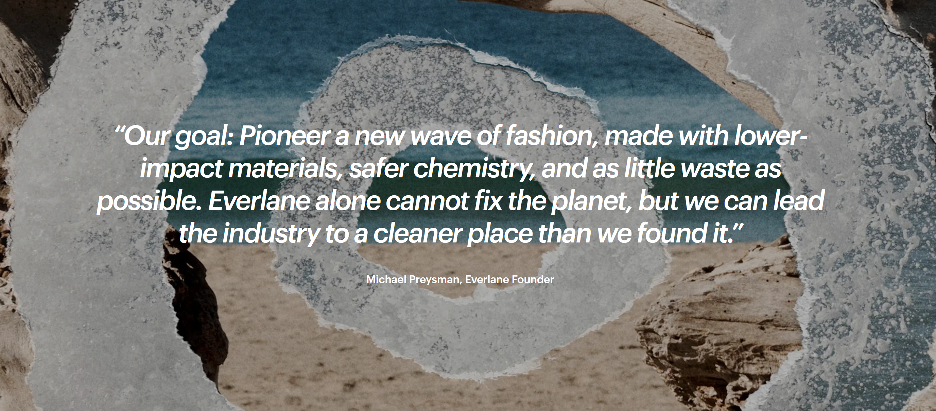
Corporate Social Responsibility

Slide 6
Research Question
Qu: What kinds of markets can easily transition to sustainable practices?
As the additional cost of green production falls, what sorts of markets will be able to shift to favor green production?
As the additional cost of green production falls, how does total CSR investment vary?
Does the competitive character of a market matter? Are competitive markets more or less malleable than consolidated ones?

Slide 7
Contributions
C1: Characterize market outcomes for two producers.
We derive the optimal/equilibrium pricing and CSR investment policies for two producers when they cooperate/compete.
We find lowering the green manufacturing costs increases the green market share and total CSR faster when the producers cooperate.
We find a green product is more readily introduced into the market when producers compete.
C2: Further generalize the model to flexible producers.
If producers can decide to produce either a green or non-green product, we prove that the green market share and total CSR investment is always higher when producers cooperate than when they compete
C3: Study properties of the many producers in balanced market
We generalize our model to the case of many producers, again find that when producers cooperate, there is significantly faster induced growth in green market share as opposed to when in competition.

Slide 8
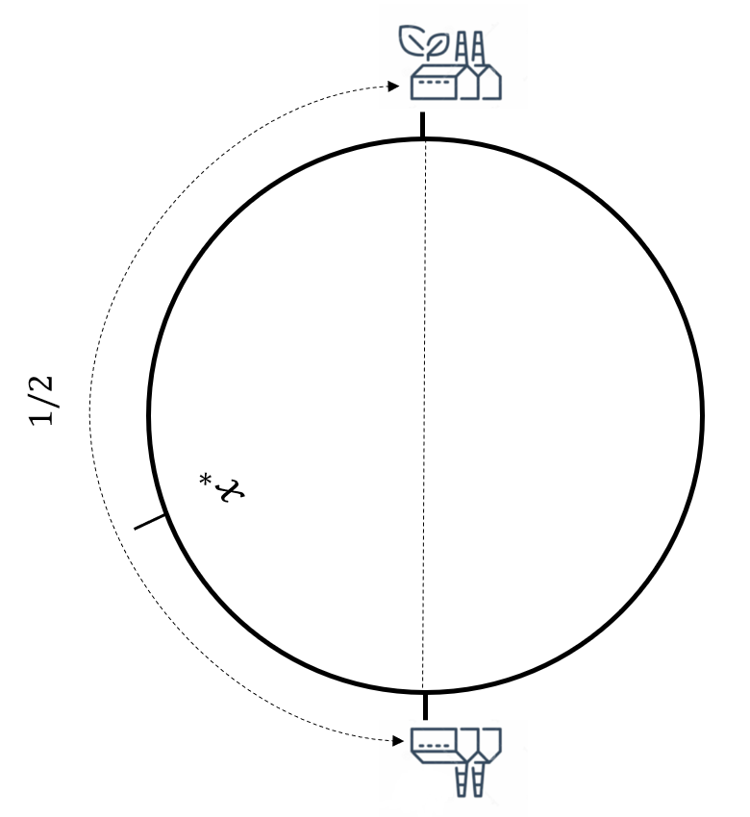
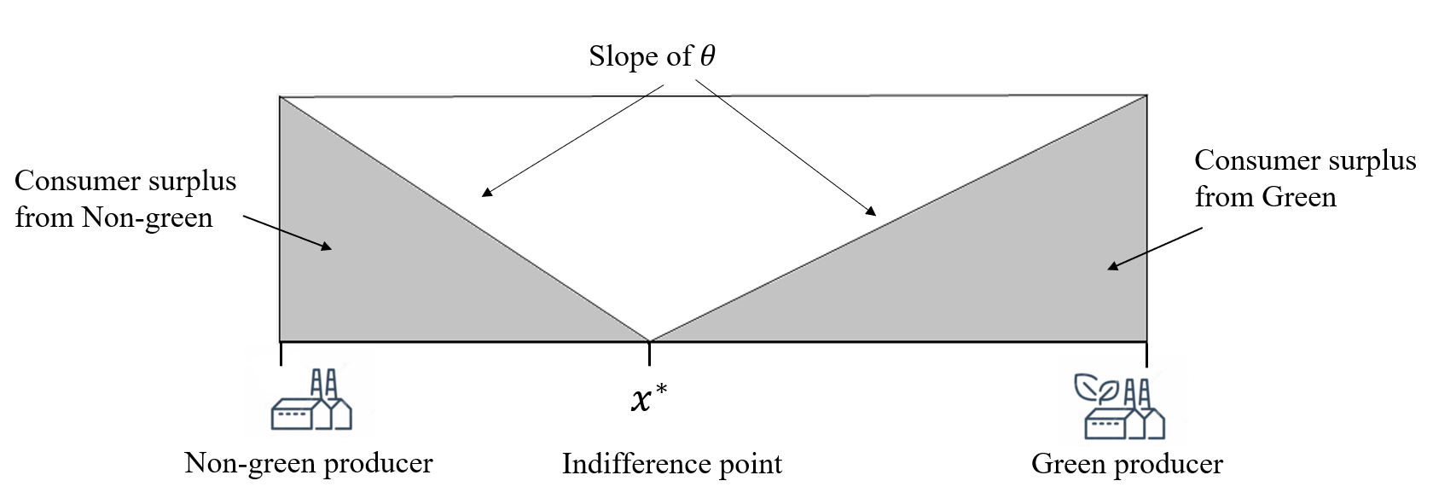
Model and Assumptions
We consider markets where producers of substitutable Non-Green product (N) and green product (G) either compete or cooperate.
Producers are located at equispaced positions on Salop's circle and set the price $p_{i}$ and the level of (CSR) investment $s_{i}$ to maximize profit.

Slide 9
Model and Assumptions
Customers are unit-demand and uniformly distributed with fixed common base valuation for the products $v$.
Customers value CSR investment at two possible rates, either $B_{G}$or $B_{N}$.
We assume $B_{G}$ ≥ $B_{N}$ due to the Halo effect

Slide 10
Model and Assumptions
Customers purchase the product that maximizes their utility, which is given by,
$$U_{i}\left(x\right)= v −θ\left|x − x_{i}\right| − p_{i}+ B_{i}s_{i}$$
where $\left|x − x_{i}\right|$ is the distance from producer $i$ on the Salop’s circle.

Slide 11
Model and Assumptions
Producer $i^{′}s$ profit is given by,
$$R_{i}\left(x\right)=\left(p_{i}−k_{i}\right)ℳ_{i}−\frac{c_{i}s_{i}^{2}}{2}$$
where $ℳ_{i}$ is the market share of producer $i$ on the Salop’s circle.

Slide 12
Monopoly and Duopoly
Theorem [Cooperation vs. Competition for Two Producers].
Suppose there are two profit-maximizing producers (Green and Non-green), located at opposing points on Salop's circle. If the parameters satisfy $B_{N}^{2}≤ c(θ−k)$and $B_{G}^{2}≤c\left(θ+k\right)$, then:
The green market share and total CSR investment is increasing as the green production cost $k$ decreases in both markets.
The increase in green market share and CSR investment is greater in the cooperative market compared to the competitive market.

Slide 13
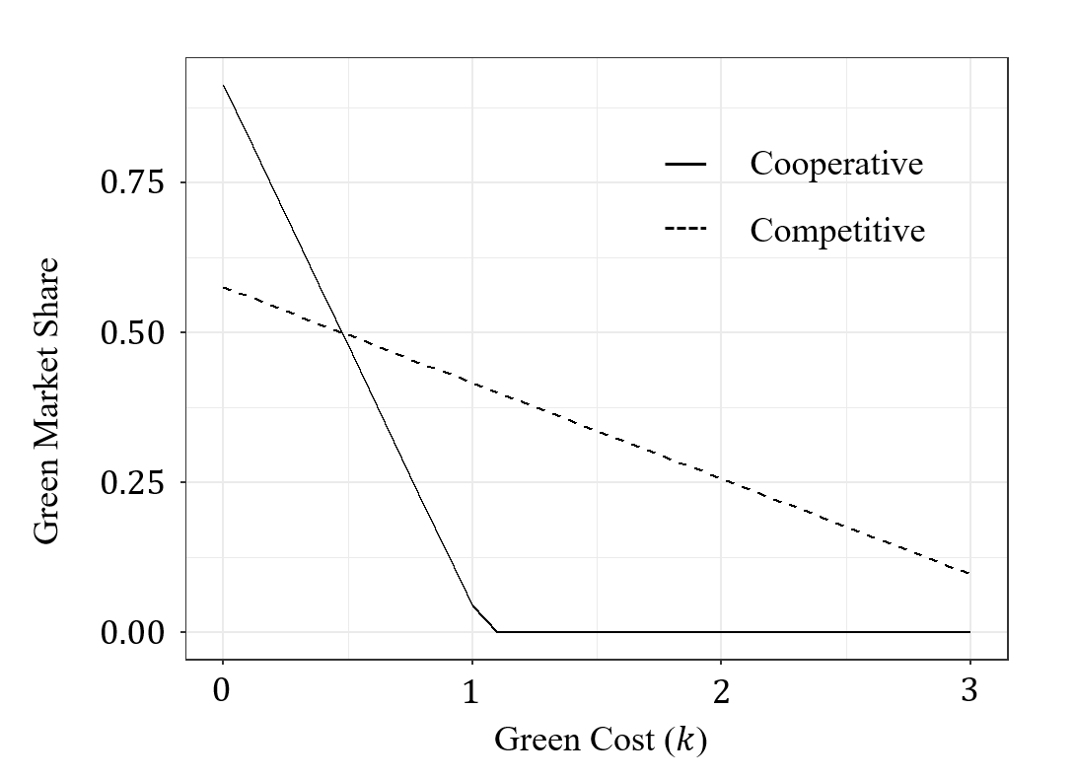
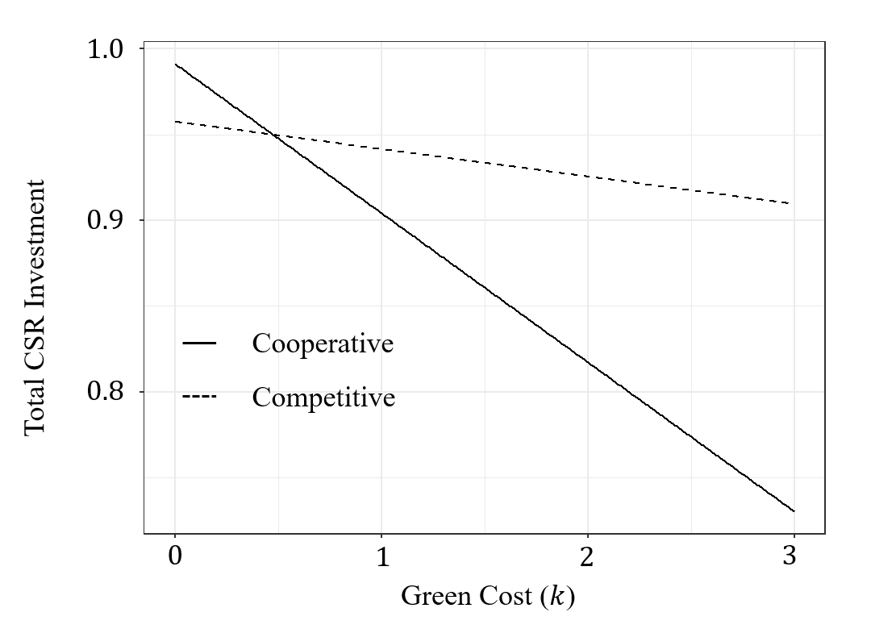
Monopoly and Duopoly
Takeaway
Decreasing green production cost will increase the green market share and total CSR investment, especially in the cooperative market.

Slide 14
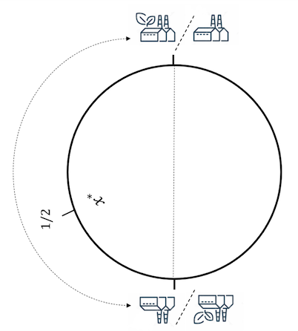
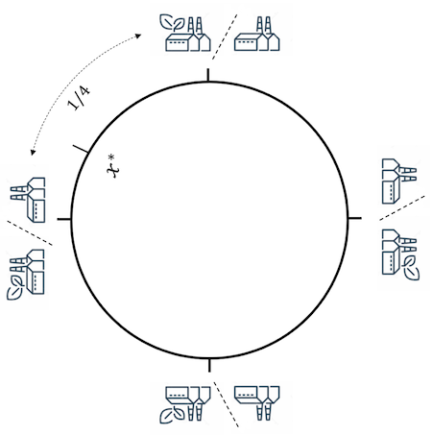
Flexible Production
Def: We call a firm flexible if the firm can choose its production type
Natural to assume firms can change their manufacturing processes
Resulting market outcomes are not longer continuous in k

Slide 15
Flexible Producers
Theorem [Cooperation vs. Competition for Flexible Producers].
Suppose there are two flexible profit-maximizing producers, located at opposing points on Salop's circle. If the parameters satisfy $B_{N}^{2}≤ cθ$and $B_{G}^{2}≤cθ$, then:
The resulting green market share is always higher when producers cooperate than when producers compete.
The total CSR investment is always higher when producers cooperate than when producers compete.
Takeaway
When producers are flexible, cooperation always leads to more sustainable market outcomes

Slide 16
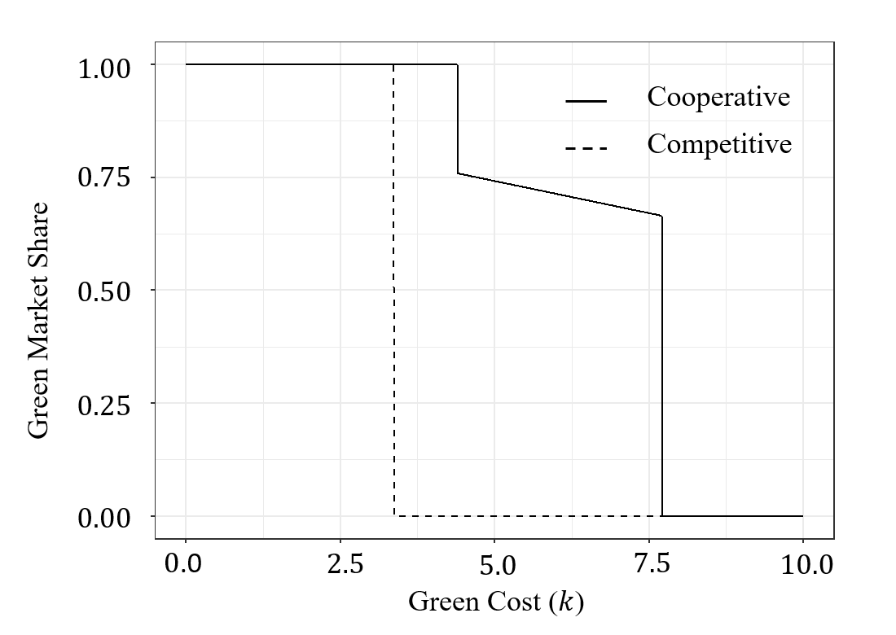
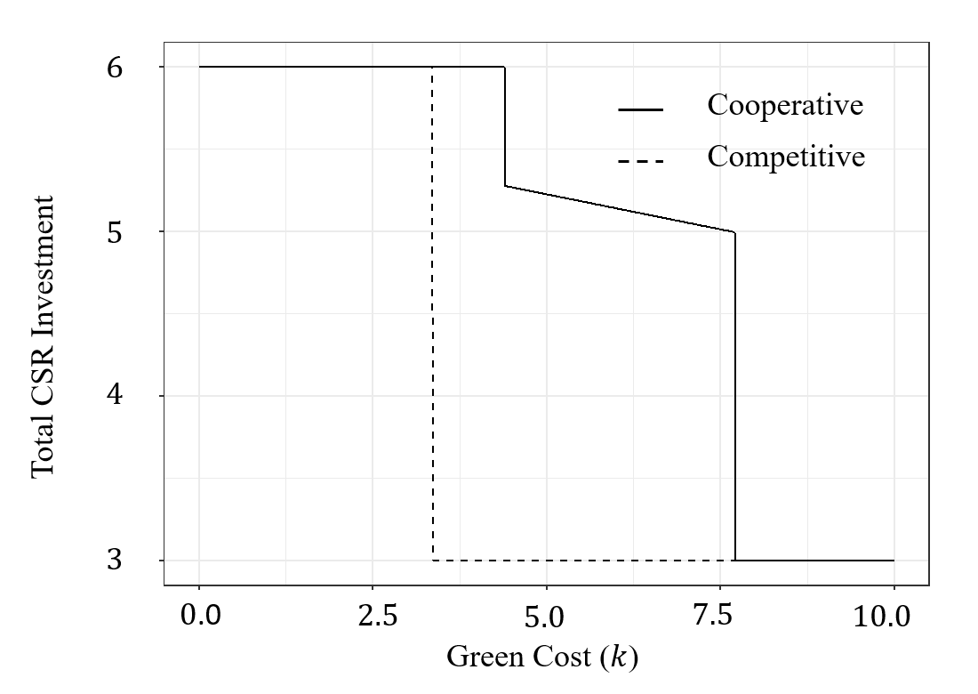
Flexible Producers
Tipping point (Competitive)
Tipping point (Cooperative)
Intuition
When producers cooperate, they can fully explore the benefit of the combination of green and non-green production. When producers compete, they cannot set a high price to cover the high green production cost.

Slide 17
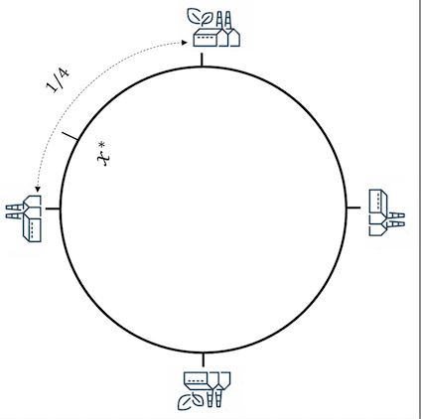
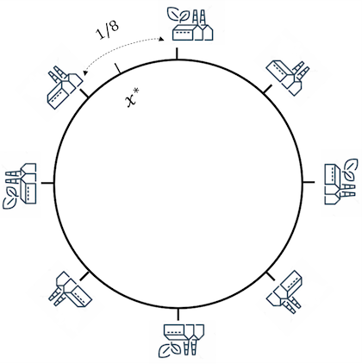
Beyond Two Producers
Increase the competition intensity by increasing the number of producers in the market.
Will assume producer types are balanced which means all green producers and all non-green producers behave identically.

Slide 18
Balanced Market
Theorem [Cooperation vs. Competition for 2n Producers].
Suppose there are 2n profit-maximizing balanced producers, equispaced on Salop's circle. If the parameters satisfy $B_{N}^{2}≤ c(θ−kn)$and $B_{G}^{2}≤c\left(θ+ kn\right)$, then:
If the producer types are fixed and alternating, decreases in k lead to greater increases in green market share and total CSR investment when firms cooperate. As n increase, this effect intensifies.
If the producers are flexible, then green market share and total CSR investment is always higher when firms cooperate.

Slide 19
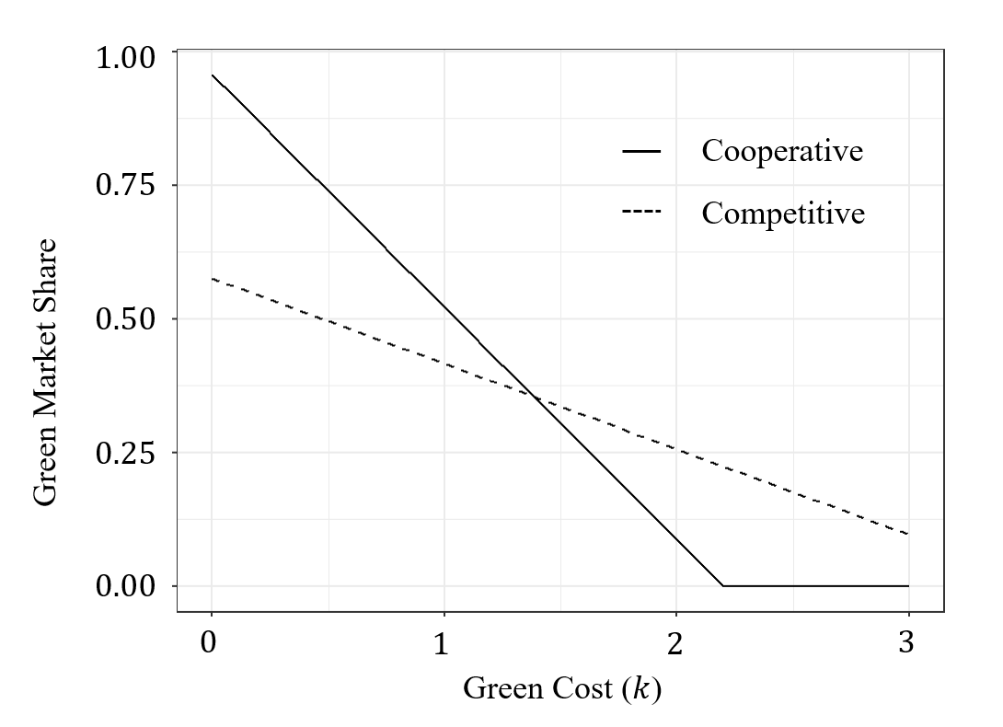
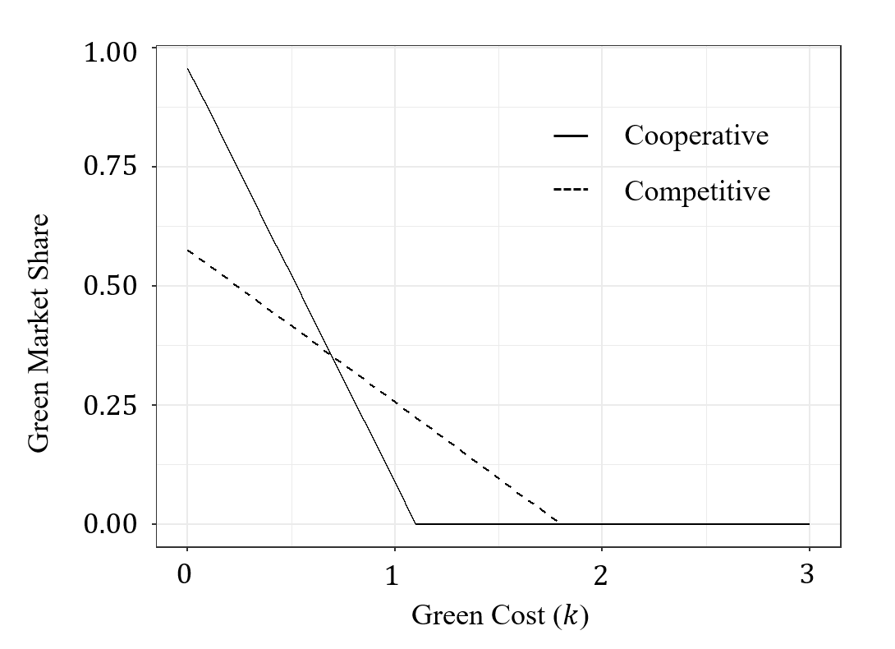
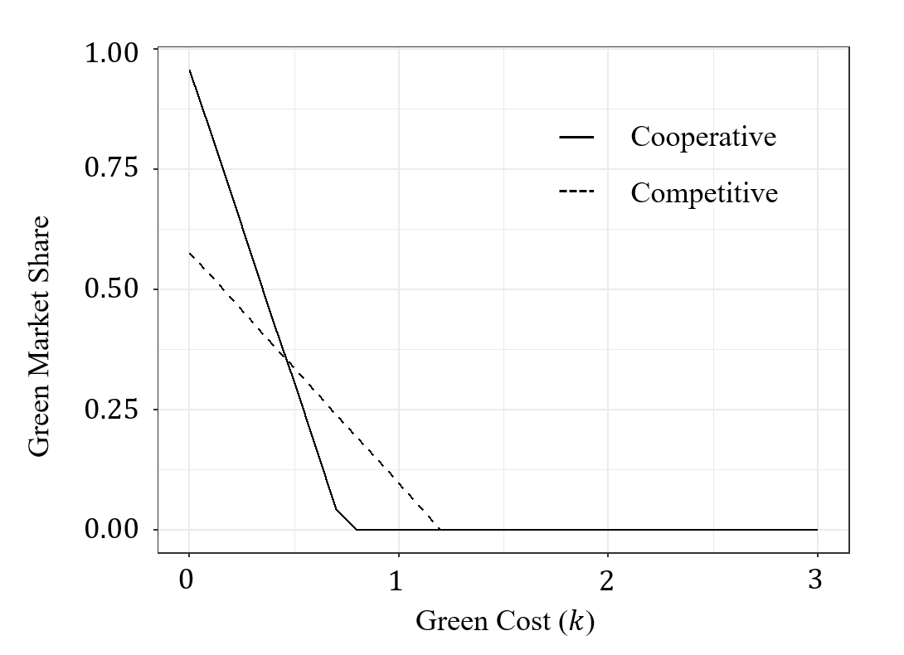
Inflexible Balanced Market
Two Producers
Four Producers
Eight Producers
Takeaway
In the inflexible balanced market, as competition intensifies, decreasing green production cost will increase the green market share and total CSR investment, especially in the cooperative market, at sharper and sharper rates!

Slide 20
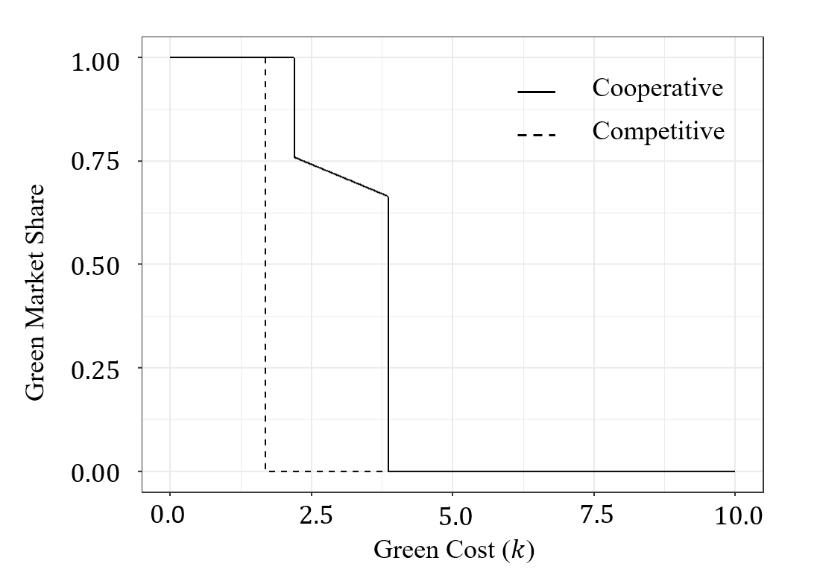
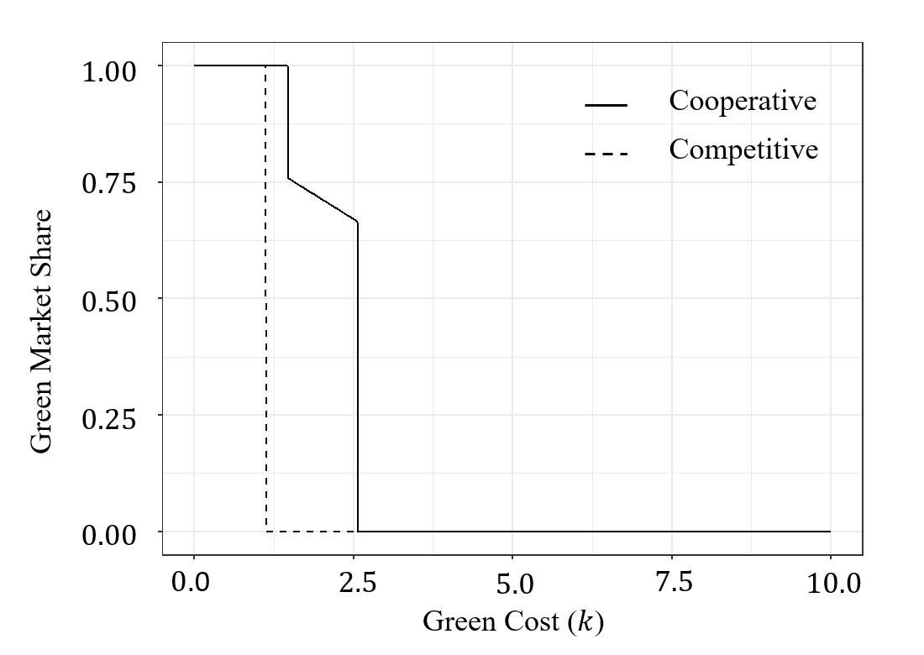
Flexible Balanced Market
Two Producers
Four Producers
Six Producers
Takeaway
In the flexible balanced market, as competition intensifies, the tipping points are going to be smaller and smaller for both cooperative and competitive market.
Notes:
It’s not consistent with previous slides, we have 2, 4, 6 producers rather than 2, 4, 8 producers.

Slide 21
Conclusions
We find decreasing green production costs will increase the green market share and total CSR investment, especially when cooperative.
Green technology is more likely to be introduced in competitive market.
When producers can flexibly choose their type, sustainable market outcomes are always greater when firms cooperate.
Our findings provide important implications for policy-makers as they offer insights into which types of markets are most impacted by green production cost reduction.

Slide 22
Thank you!
Full paper: https://papers.ssrn.com/sol3/papers.cfm?abstract_id=4344348
Comments, questions @ tic54@pitt.edu
More papers: https://tcui-pitt.github.io/

