Slide 1
Project 412Connect: Bridging Students and Communities
Alex DiChristofano¹, Michael L. Hamilton², Qiqi Hao², Sera Linardi³
¹ Division of Computational & Data Sciences, Washington University in St. Louis,
² Katz Graduate School of Business, University of Pittsburgh,
³ Graduate School of Public and International Affairs (GSPIA), University of Pittsburgh
Notes:
YinzOR
This is a project that came out the community at pitt, lots of volunteers worked on it
These are the academic autho

Slide 2
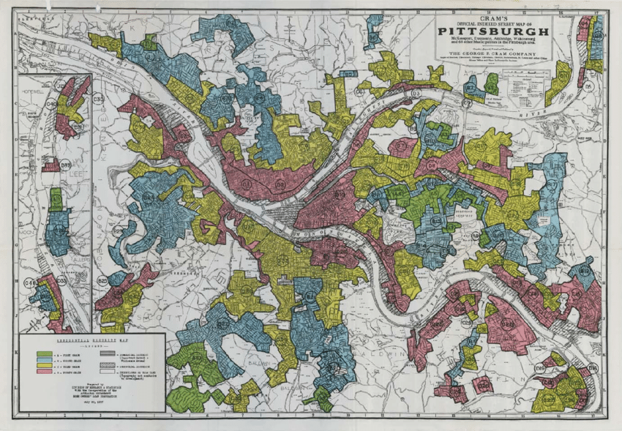
Pittsburgh, Black-Owned Businesses, and COVID-19
Right is a map of neighborhood designations for mortgage appraisal from the 1930s^{[2]}
Privately used for lending decisions
A time of new deal transformation in the mortgage market, making 30 years mortgage increasing available and affordable^{[1]}
Strong neighborhood bias. Green neighborhoods had access to capital and persistent high value home ownership, Red did not.
Map of Pittsburgh circa 1930. Colored for building quality
Key: Red – Hazardous, Yellow – Declining, Blue – Good, Green - Best
[1] Rothstein, R. 2017. The color of law: A forgotten history of how our government segregated America.
[2] Rutan, Devin. 2016. Legacies of Residential Security Maps: Measuring the Persistent Effects of Redling in Pittsburgh
Notes:
To motivate this project I want to start way back in Pittsburgh in the 1930s…
Mention this was designated by banks, lots of opportunity to perpuate bias and injustice

Slide 3
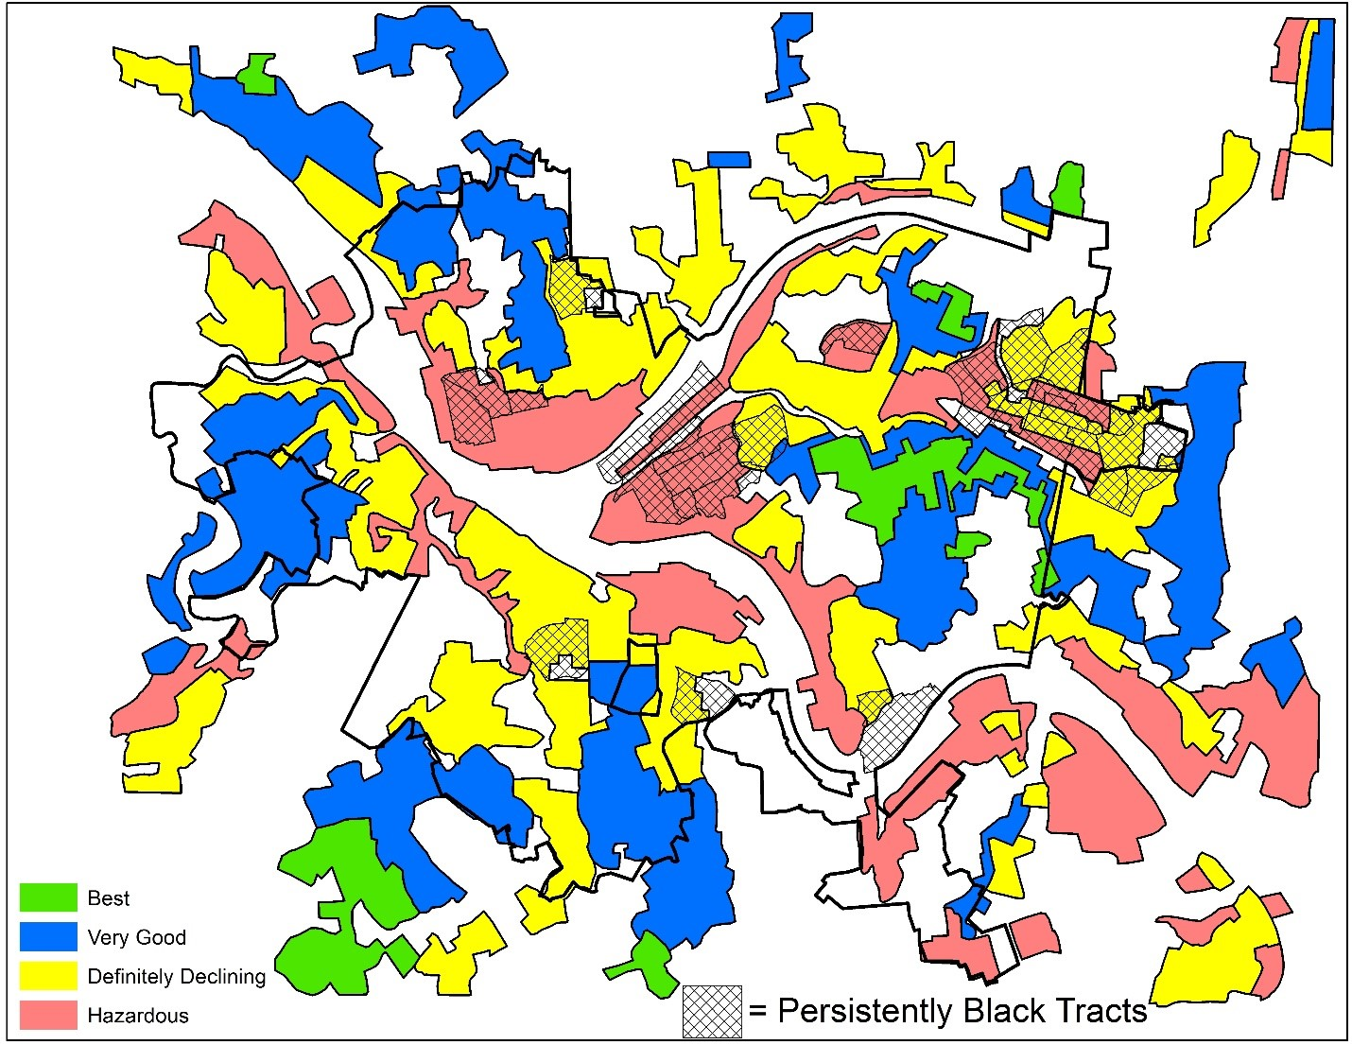
Pittsburgh, Black-Owned Businesses, and COVID-19
Right is a map of neighborhood designations for mortgage appraisal from the 1930s^{[2]}
Privately used for lending decisions
Historically black neighborhoods are geographically separated from high value neighborhoods^{[2]}
Through redlining, historically black neighborhoods in Pittsburgh have been under invested in and undeveloped^{[1,2]}
Map of Pittsburgh circa 1930. Colored for building quality
Shaded are Black neighborhoods
[1] Rothstein, R. 2017. The color of law: A forgotten history of how our government segregated America.
[2] Rutan, Devin. 2016. Legacies of Residential Security Maps: Measuring the Persistent Effects of Redling in Pittsburgh
Notes:
We see that black neighborhoods low value designated neighborhoods
This is colloquially known as red lining, where fiscal policy diseffranchises black americans

Slide 4
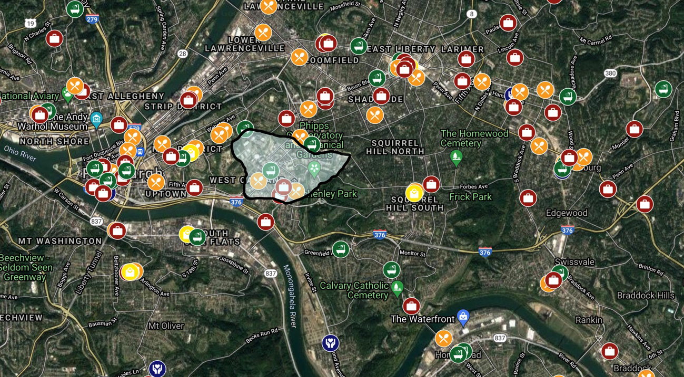
Pittsburgh, Black-Owned Businesses, and COVID-19
Today, Black-owned businesses are often geographically segregated from areas of high economic activity and target markets have insufficient information about them ^{[29, 31]}
Since the beginning of the pandemic, Black-owned businesses have closed at a rate of more than two times of that of their white counterparts and cash balances have decreased more than nine times that of their white counterparts ^{[27]}
Through market research, identified a lack of connection between Pittsburgh Black-owned business and the university community
Map of Pittsburgh Black-owned businesses created in collaboration with community partners
shaded region: Pittsburgh university community
[27] Lucas Misera. 2020. An Uphill Battle: COVID-19’s Outsized Toll on Minority-Owned Firms.
[29] Sean F Reardon, Stephen A Matthews, David O’Sullivan, Barrett A Lee, Glenn Firebaugh, Chad R Farrell, and Kendra Bischoff. 2008. The geographic scale of metropolitan racial segregation. [31] Devin Q Rutan and Michael R Glass. 2018. The lingering effects of neighborhood appraisal: evaluating redlining’s legacy in Pittsburgh.
Survey data collected in partnership with community collaborators, including Alex Jackson at the Pittsburgh Hub of Data for Black Lives.
Map Data: ©2021, Google. Imagery: ©2021, Landsat/Copernicus, Maxar Technologies, Sanborn, U.S. Geological Survey, USDA Farm Service Agency.
Notes:
Fast forward to today
Black neighborhoods are still geographically distinct
Moreover, since the pandemic which was extremely damaging for small business owners,
What we noted is there is a gap between the university community and local BoB

Slide 5
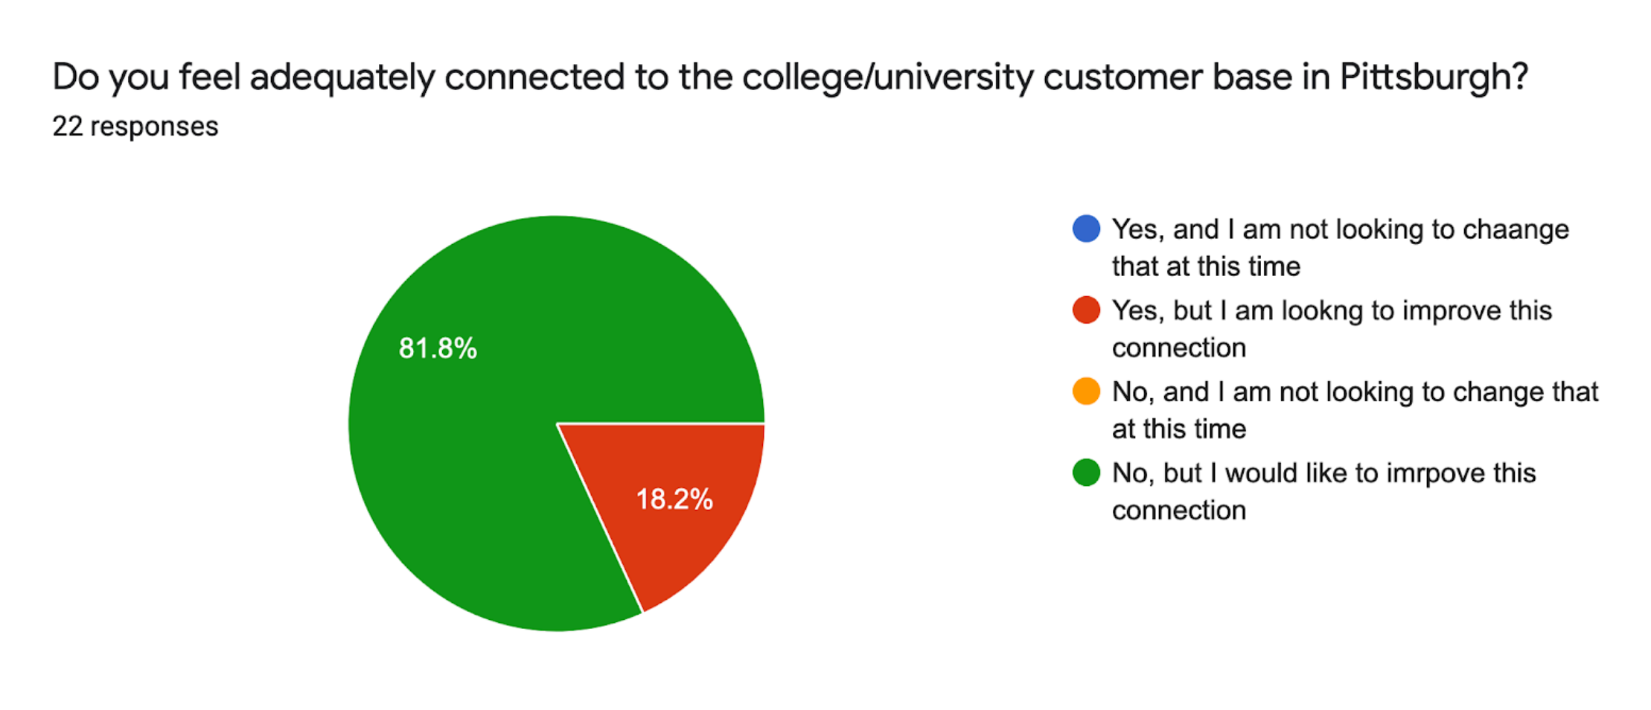
Black-Owned Business Survey (February and March 2021)
Surveyed 22 Pittsburgh Black business owners
85% of respondents ranked reaching new customer bases as an extremely important goal
61% felt inadequately linked to their community
85% felt inadequately linked to the university community and wanted to improve this connection
54% desired increased social media support.
Map of Pittsburgh Black-owned businesses created in collaboration with community partners
shaded region: Pittsburgh university community
Survey data collected in partnership with community collaborators, including Alex Jackson at the Pittsburgh Hub of Data for Black Lives.
Map Data: ©2021, Google. Imagery: ©2021, Landsat/Copernicus, Maxar Technologies, Sanborn, U.S. Geological Survey, USDA Farm Service Agency.
Notes:
One of the things our community collaborators did early on was to conduct a survey to try and understand some of the goals of Black businesses owners
And some of the of the key takeaways were that, while these businesses were generally looking to reach new customers and connect with their communities, they especially felt disconnected from the university community and wanted to improve this connection
And we see that some of the themes from this survey also appear in the geographic distribution of businesses and the university community
On the right you can see a map of Black-owned businesses in Pittsburgh which we’ve made in collaboration with our community partners
The shaded area is the University of Pittsburgh community, and you can see that a significant proportion of businesses fall outside of this area

Slide 6
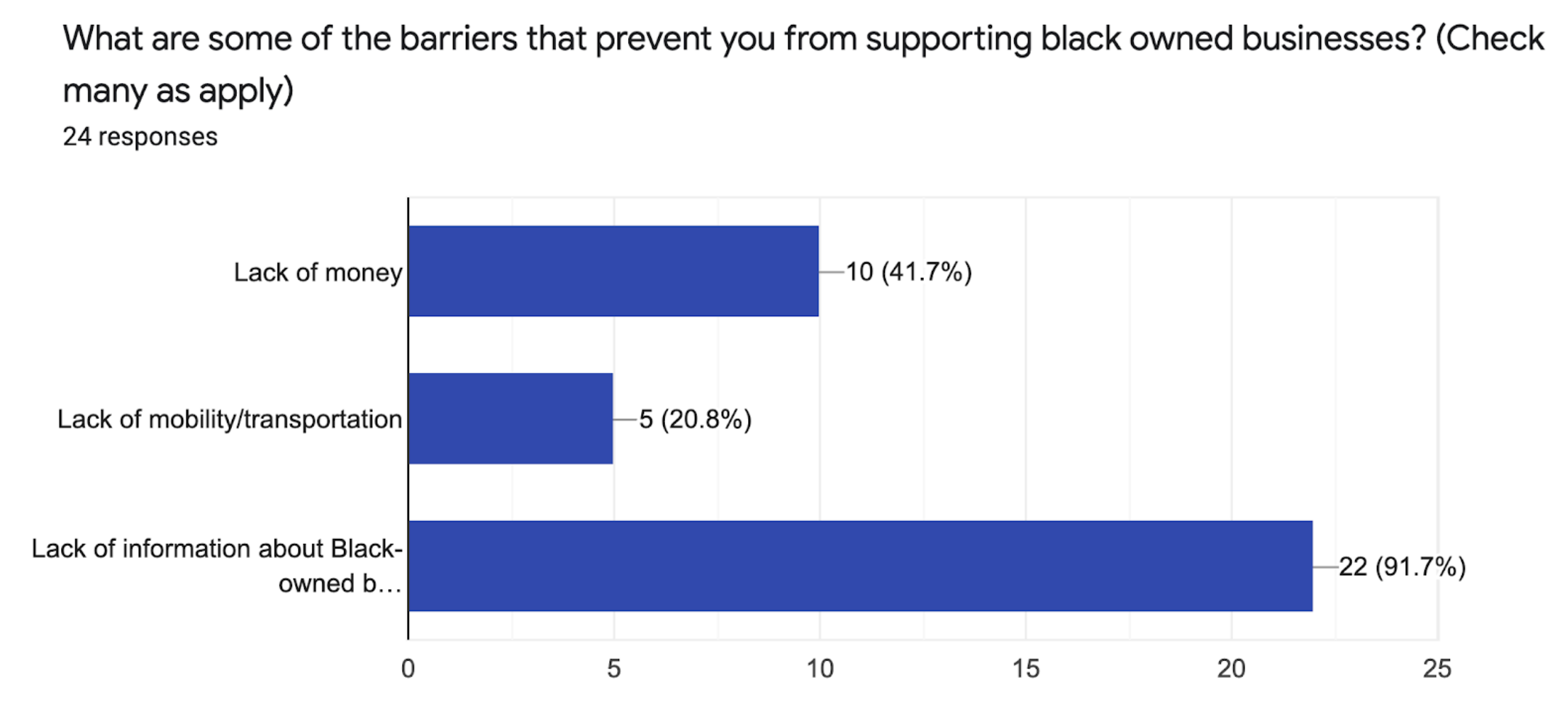
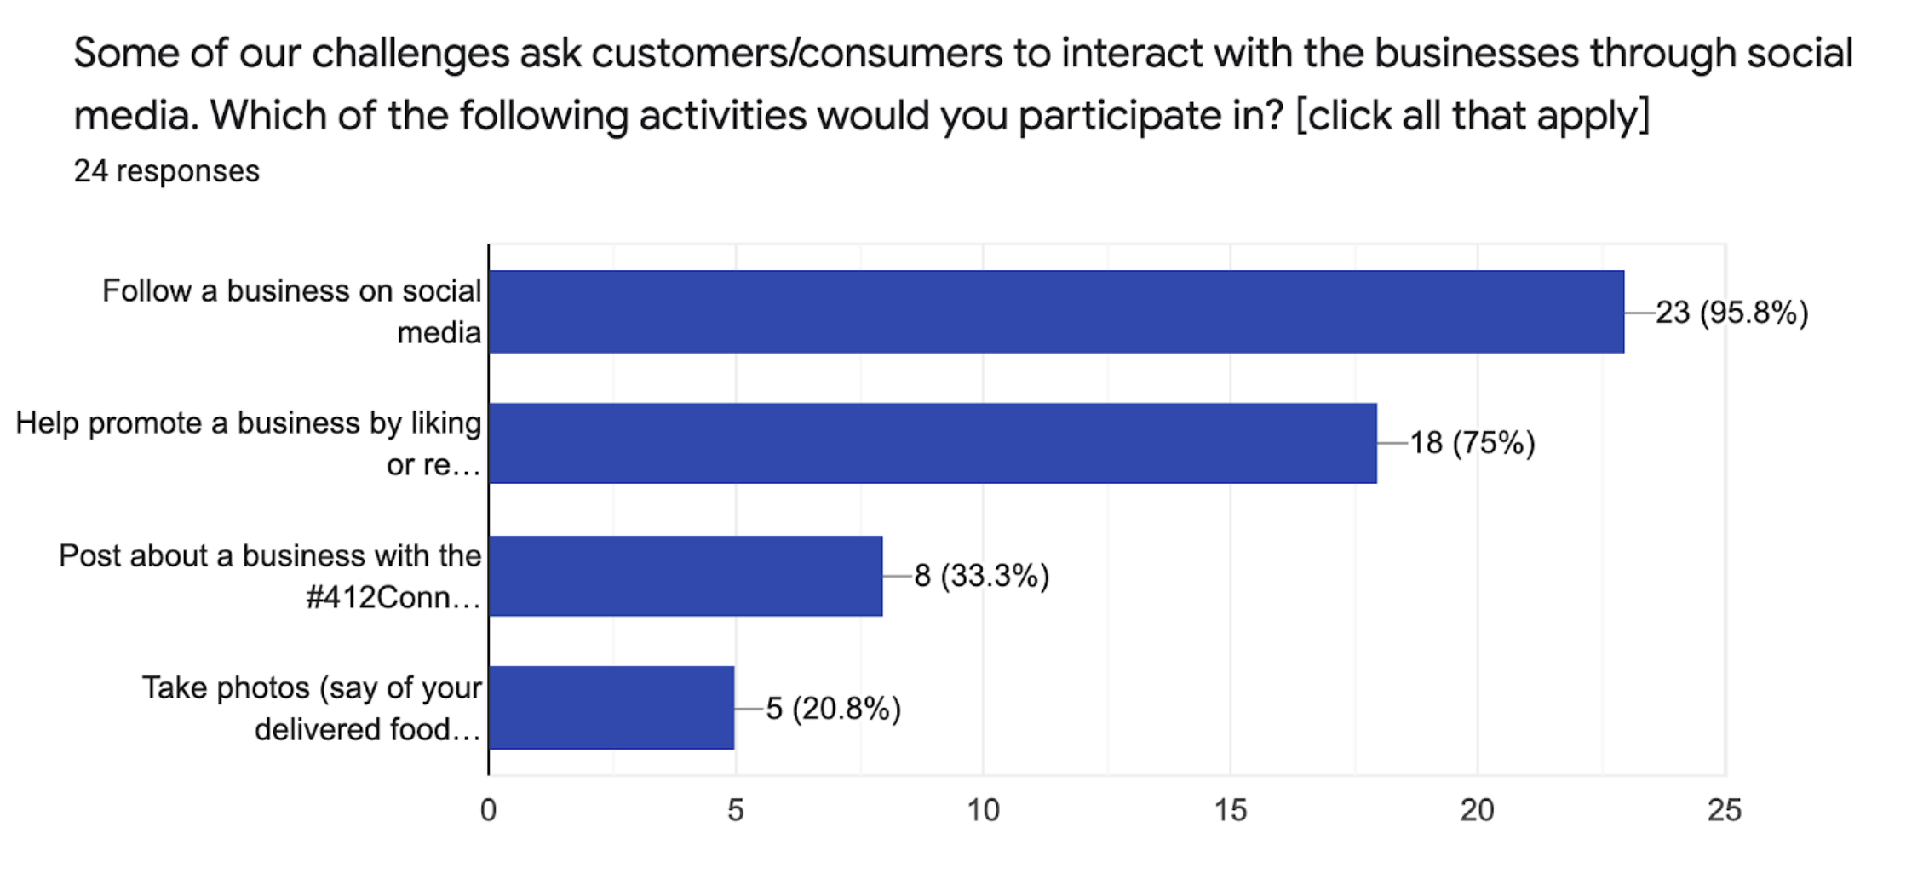
Student Survey (March 2021)
Surveyed members of the University of Pittsburgh student body
92% of respondents have a desire to support and patron Black-owned businesses
Only 50% could name a local Black-owned business
Respondents expressed that their greatest barriers to interaction with Black-owned business were a lack of knowledge about businesses and their services (92%), financial constraints (42%), and lack of transportation (21%)
Students are most likely to support Black-owned businesses through social media interaction and are most likely to visit Black-owned businesses in the food industry
Participants stated that they are more likely to visit businesses with good “word of mouth” reputation (100%), a strong online presence (92%), and unique services (83%)
Survey data collected by the 412Connect Community Engagement Team.
Notes:
After conducting our business survey, we wanted to try and understand the other side of this connection, namely, university students
What we found was a little interesting, although perhaps not completely unexpected – almost all respondents said they wanted to support Black-owned businesses, but only half could actually name a local Black-owned business
We also saw that a business’s online presence was important to students – it was something they looked for when exploring new businesses, and it was a way that many of them were willing to interact with businesses, especially because it removed financial and geographical constraints

Slide 7
Contributions
We build a platform to bridge gaps between two communities
We propose a novel model for the linking of university students to local Black-owned. In coordination with our community partners, we designed and implemented our online platform so that it may serve as a useful example for other socially conscious platform designers.
We design an incentive system and recommendation system to power the site
We describe simple approaches to badge design and content recommendation that are tailored to our application. For the problem of badge design, we prove a number of structural properties that and guide our implementation. For content recommendation we give a new framework based on linear hints to motivate our policy.
We analyze the data from Fall 2021 and Fall 2022
Each run features a dozen local black own businesses and hundreds of student participants. Thousand of business impressions were served. We reflect on how users reacted to our design choices
Data for Black Lives.
Map Data: ©2021, Google. Imagery: ©2021, Landsat/Copernicus, Maxar Technologies, Sanborn, U.S. Geological Survey, USDA Farm Service Agency.
Notes:
First, we give a novel model to describe the pricing for online dating platforms and prove bounds on the profit ratio of (FP) to the optimal achievable profits.
Next, We study the impact of marginal operating cost. when the marginal operating cost, c, is small, and show larger payment periods are better for both profit and welfare.
Finally, we look at heterogenous matching rates. But today, I’m only going to discuss the first two results.

Slide 8
Two-Sided Market Platform Design
Black-Owned Businesses
What type of support do you need to promote your business?
website creation/web updating
advertising
social media marketing
website integration with other systems
increased press and presence
Students
What social media activities would you participate in?
follow a business on social media (96%)
help promote a business by liking or retweeting their posts (75%)
post about a business with the #412Connect hashtag (33%)
take photos and post reviews online (21%)
412Connect
a local organization-curated platform to connect Black-owned businesses and university students through social media and online discovery
Survey data collected in partnership with community collaborators, including Alex Jackson at the Pittsburgh Hub of Data for Black Lives.
Notes:
done

Slide 9
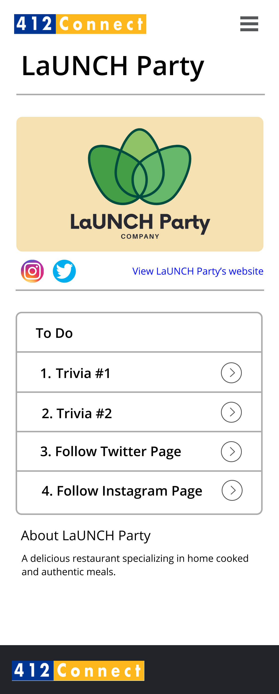
412Connect Platform Flow
Notes:
done

Slide 10
412Connect Dashboard
badges
shows current progress representing the two types of tasks
trivia
social media
business display
suggests businesses for users one at a time
clicking on the display leads you to the business profile
Notes:
done

Slide 11
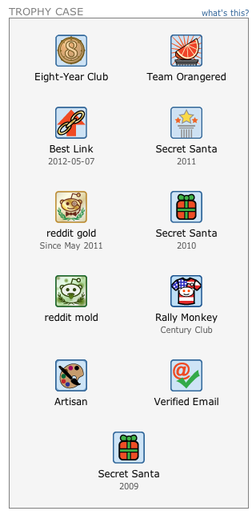
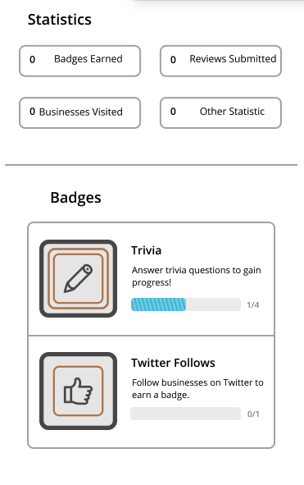
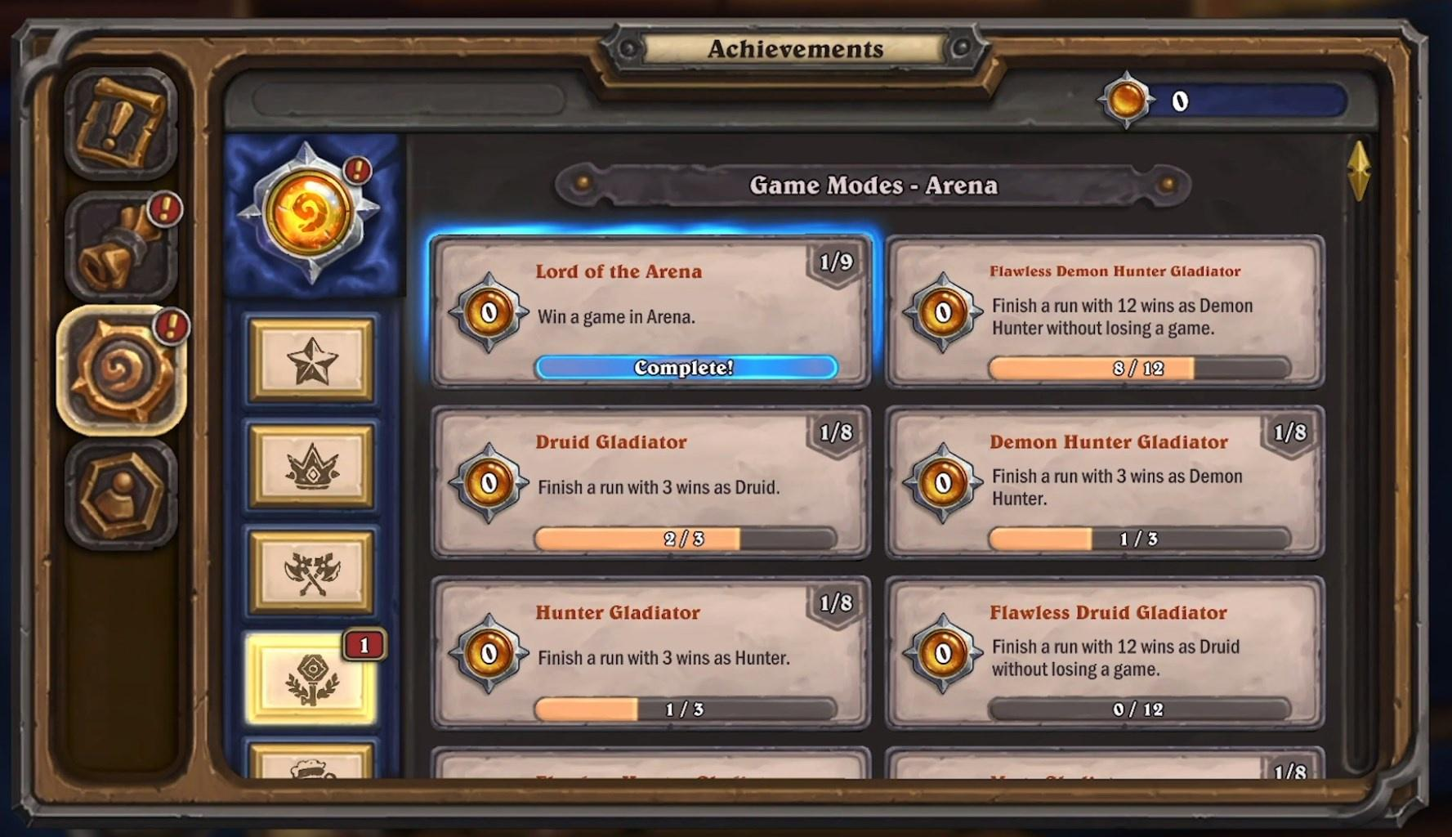
412Connect Platform: Badge System
A Badge System provides non-monetary rewards to participants for desired behavior.
Altruistic participants
Good user experience
Qu: Why do you give badges?^{[1]}
1. Reputation
2. Group Identification
3. Goal setting
4. Refreshing Motivation
Ex 3: reddit.com Badges
Project 412 Badges
Ex 1: Hearthstone Badges
Ex 2: math.stackexchange.com Badges
[1] Facey-Shaw et al. 2017. Educational functions and design of badge systems: A conceptual review.
Notes:
First, we give a novel model to describe the pricing for online dating platforms and prove bounds on the profit ratio of (FP) to the optimal achievable profits.
Next, We study the impact of marginal operating cost. when the marginal operating cost, c, is small, and show larger payment periods are better for both profit and welfare.
Finally, we look at heterogenous matching rates. But today, I’m only going to discuss the first two results.

Slide 12
412Connect Platform: Badge System
A Badge System provides non-monetary rewards to participants for desired behavior.
Model:
Users draw a willingness to contribute from dist. F
Mechanics:
If they earn a badge, draw again from F
Otherwise, leave
Qu: How do you give badges?
Fix a number of badges (say 3)
Want to choose thresholds to award them
Objective: Maximize expected activity
T₁
T₂
T₃
Number of tasks completed
Notes:
First, we give a novel model to describe the pricing for online dating platforms and prove bounds on the profit ratio of (FP) to the optimal achievable profits.
Next, We study the impact of marginal operating cost. when the marginal operating cost, c, is small, and show larger payment periods are better for both profit and welfare.
Finally, we look at heterogenous matching rates. But today, I’m only going to discuss the first two results.

Slide 13
412Connect Platform: Badge System
Definition: Let a distribution F with density f be log-concave if log(f(x)) is a concave function
Theorem 1 [Badge Structure].
For all positive valued log-concave distributions $F$ and fixed K, the set of optimal badge thresholds satisfy the following properties:
Thresholds are unique and additional work (i.e. T_{i+1} - T_{i}) required is increasing
Maximum additional work is upper bounded by a distribution dependent constant
The marginal increase in activity for each level of badge is monotone decreasing
Bronze Community Explorer Badge
Work
More Work
Silver Social Amplifier Badge
T₁
T₂
T₃
Number of tasks completed
Notes:
done

Slide 14
412Connect Platform: Badge System
Definition: Let a distribution F with density f be log-concave if log(f(x)) is a concave function
Theorem 1 [Badge Structure].
For all positive valued log-concave distributions $F$ and fixed K, the set of optimal badge thresholds satisfy the following properties:
Thresholds are unique and additional work (i.e. T_{i+1} - T_{i}) required is increasing
Maximum additional work is upper bounded by a distribution dependent constant
The marginal increase in activity for each level of badge is monotone decreasing
Bronze Community Explorer Badge
Highlights
Intuitive rules.
Nix’s linear badge requirements, doubling requirements etc.
First couple badges capture most of the potential value
Silver Social Amplifier Badge
Notes:
done

Slide 15
412Connect Platform: Badge System
Definition: Let a distribution F with density f be log-concave if log(f(x)) is a concave function
Theorem 1 [Badge Structure].
For all positive valued log-concave distributions $F$ and fixed K, the set of optimal badge thresholds satisfy the following properties:
Thresholds are unique and additional work (i.e. T_{i+1} - T_{i}) required is increasing
Maximum additional work is upper bounded by a distribution dependent constant
The marginal increase in activity for each level of badge is monotone decreasing
Bronze Community Explorer Badge
Theory to practice
We assumed uniform motivation, and used them to compute three thresholds
F ~ Uni[1,15] implies T₁ = 1, T₂ = 6, and T₃ = 13
Silver Social Amplifier Badge
Notes:
done

Slide 16
412Connect Platform: Recommendation Policies
Recommendation policies for 412: Properties
1. Dictates the order in which businesses are presented to a user
Let Σ_{k} be the set of permutations on k
2. The probability of a user interacting with a business is decreases with display order placement
Cascade model - decreasing exponentially at rate 𝛿
3. Users report preferences. Binary, set of preferred a business types
For each user two sets: Preferred and ~Preferred.
4. Maintains the sum of expected engagement from all users as a running total for each business
R_{t}(B_{i}) is the total engagement of business B_{i} at time t
Reward depends on preferences and position
Ex: Business shown in some order in Kiosk
in preference
out of preference
1
2
3
4
5
Ex: Specifies which of the business they prefer to see
Notes:
done

Slide 17
412Connect Platform: Recommendation Policies
Challenges:
No idea what the arrival process is like:
Preferences could be very imbalanced
Hard trade-offs between fairness and efficiency
Don’t know how many people will show up
Difficult to run learning algorithms
2. Must make sure every business that signs gets ample traffic
Don’t want to make winners and losers
Site is meant to promote local business!
Simple to implement
No dynamic updates
No complicated computation
Ex: Business shown in some order in Kiosk
in preference
out of preference
1
2
3
4
5
Ex: Specifies which of the business they prefer to see
Notes:
done

Slide 18
412Connect Platform: Recommendation Model
Model for Recommendation:
Encode preferences as binary weighted vector in u_{i} in {α, β}^{K}
Recommendations are permutations r_{i} = 𝜎_{i}(𝛿¹, 𝛿², 𝛿³… 𝛿^{K})
Value of recommendation: <r_{i} , u_{i} >
Value to B_{j} is r_{i,j} u_{i,j}
$$π$$
B₁ | B₂ | B₃ | B₄
B₁ | B₂ | B₃ | B₄
u₁
α
β
α
β
r₁
𝛿¹
𝛿²
𝛿³
𝛿⁴
u₂
α
α
β
β
r₂
𝛿³
𝛿⁴
𝛿¹
𝛿²
u₃
α
α
α
α
r₃
𝛿²
𝛿³
𝛿⁴
Efficiency
Def: Sum of Outcomes
𝛿¹
u₄
β
β
β
β
r₄
𝛿¹
𝛿²
𝛿³
𝛿⁴
u₅
α
β
α
β
𝛿⁴
𝛿³
𝛿²
r₅
𝛿¹
Fairness
Def: Variance of Outcomes (lower is better)
Notes:
First, we give a novel model to describe the pricing for online dating platforms and prove bounds on the profit ratio of (FP) to the optimal achievable profits.
Next, We study the impact of marginal operating cost. when the marginal operating cost, c, is small, and show larger payment periods are better for both profit and welfare.
Finally, we look at heterogenous matching rates. But today, I’m only going to discuss the first two results.

Slide 19
Recommendation Model with Linear Hints
Model for Recommendation:
Encode preferences as binary weighted vector in u_{i} in {α, β}^{K}
Recommendations are permutations r_{i} = 𝜎_{i}(𝛿¹, 𝛿², 𝛿³… 𝛿^{K})
Value of recommendation: <r_{i} , u_{i} >
Value to B_{j} is r_{i,j} u_{i,j}
Linear Hints:
Suppose an omnipotent entity could give us a hint
Hint helps us make trade-offs between fairness and efficiency
New Value of recommendation: <r_{i} , u_{i} + f_{i} >
Value to B_{j} is still r_{i,j} u_{i,j}
$$π$$
Optimal Policy with Hints:
Just recommend in order of (f_{i,j} + u_{i,j})
Note: A big hint can force any recommendation order.
We say a sequence of hints that induces a recommendation implements that policy
Helpful?
B₁ | B₂ | B₃ | B₄
B₁ | B₂ | B₃ | B₄
B₁ | B₂ | B₃ | B₄
u₁
α
β
α
β
f₁
f₁₁
f₁₂
f₁₃
f₁₄
r₁
𝛿¹
𝛿²
𝛿³
𝛿⁴
u₂
α
α
β
β
f₂
f₂₁
f₂₂
f₂₃
f₂₄
r₂
𝛿³
𝛿⁴
𝛿¹
𝛿²
u₃
α
α
α
α
f₃
f₃₁
f₃₂
f₃₃
f₃₄
r₃
𝛿²
𝛿³
𝛿⁴
𝛿¹
u₄
β
β
β
β
f₄
f₄₁
f₄₂
f₄₃
f₄₄
r₄
𝛿¹
𝛿²
𝛿³
𝛿⁴
u₅
α
β
α
β
f₅₁
f₅₂
f₅₃
f₅₄
𝛿⁴
𝛿³
𝛿²
𝛿¹
f₅
r₅
Notes:
First, we give a novel model to describe the pricing for online dating platforms and prove bounds on the profit ratio of (FP) to the optimal achievable profits.
Next, We study the impact of marginal operating cost. when the marginal operating cost, c, is small, and show larger payment periods are better for both profit and welfare.
Finally, we look at heterogenous matching rates. But today, I’m only going to discuss the first two results.

Slide 20
412Connect Platform: Recommendation Model Theory
Definition: Given a sequence of customer arrivals {u_{i}}, we call a policy undominated if there does not exist another sequence of policy recommendations that achieves both higher efficiency (i.e. dot products of rec. order and pref.) and lower unfairness (variance of outcomes).
Lemma [Hint Structure].
Let R_{t}(B_{i}) be the total reward of business i at time t. For every binary {u_{t}}, and every possible undominated policy {r_{t}}, there exists a sequence of linear hints {f_{t}}, that implements it such that if:
R_{t}(B_{i}) ≥ R_{t}(B_{j}) then f_{t,j} ≥ f_{t,i} for all pairs i, j
Takeaway
Hints tell us how to deviate from pref. set to increase fairness
Lemma states hints are always in reverse order of current business reward!
Notes:
done

Slide 21
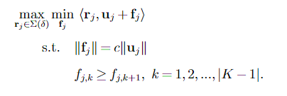
412Connect Platform: Recommendation Model Theory
Natural Robust Optimization Problem
Treat hints as variables, find maximin optimal recommendation policy given that the hints must be in reverse order of the current business rewards R_{t}(B_{i})
Also imagine there is some c which controls the weight of the hint vector
(P)
Theorem 2 [Robust Policy Structure System].
For every value of c and binary pref. u_{j}, the optimal recommendation order of (P) either follows the sorted order of u_{j}, or it follows the sorted order of f_{j}
Takeaway
Only two choices, do what is efficient (rec. based on pref.) or do what is fair (rec. based on curr. values)
Notes:
done

Slide 22
412Connect Platform: Recommendation System
412 Recommendation Algorithm:
0. All users input their preferences for business types at sign-up
1. Each user is randomly assigned one of two types with equal probability:
Fair (does not respect preferences)
Chooses the display order which keeps the variance of totals of expected engagement among closest together
Efficient (respects preferences)
Follows the rule above with the additional constraint that all in-preference businesses must be displayed before those which are out-of-preference.
in preference
out of preference
does not respect preferences
respects preferences
Note:
The one half is chosen arbitrarily
Not necessarily pareto-efficient
Notes:
done

Slide 23
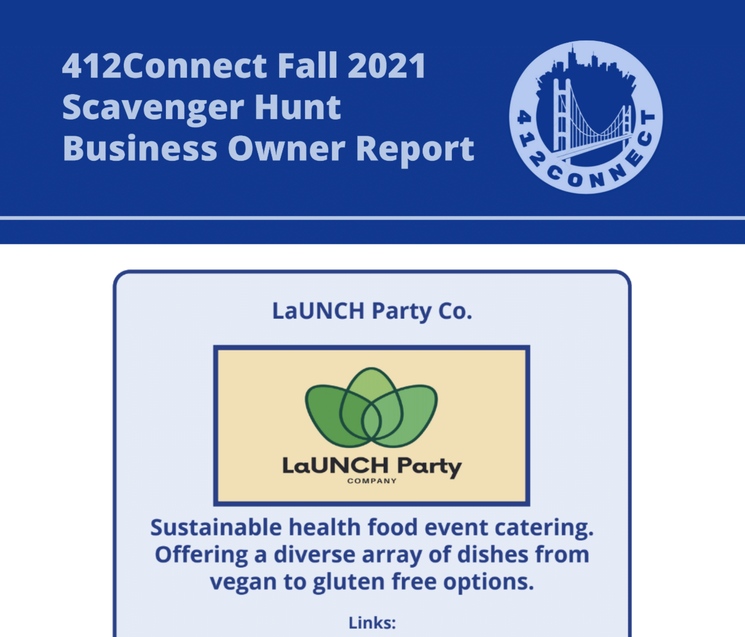
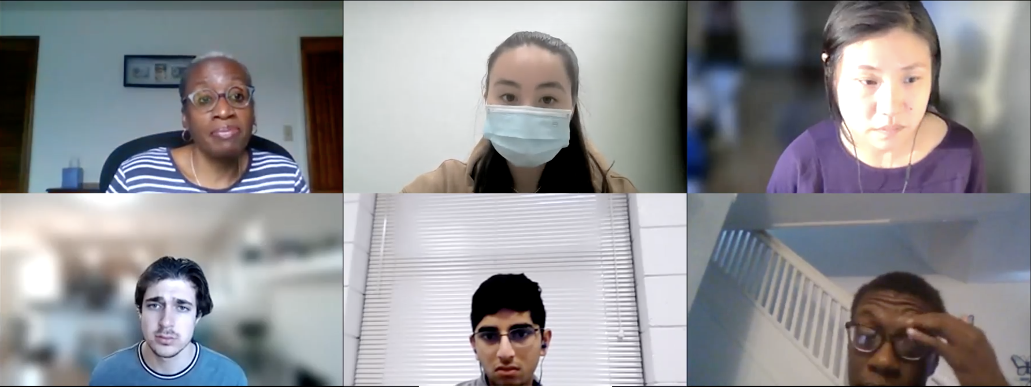
Numerics: Fall 2021 and Fall 2022 Launches
Fall 2021 Launch
August 23rd – September 23rd , 2021
15 participating businesses
155 users
501 social tasks completed
964 trivia questions answered
Fall 2022 Launch
August 23rd – September 23rd , 2022
9 participating businesses
210 users
438 social tasks completed
900 trivia questions answered
Notes:
ADD SLIDE ABOUT WHAT HAPPENED
Number of users, number of impressions, number of clicks
survey of satisfaction (business reports)
ongoing to be run again

Slide 24
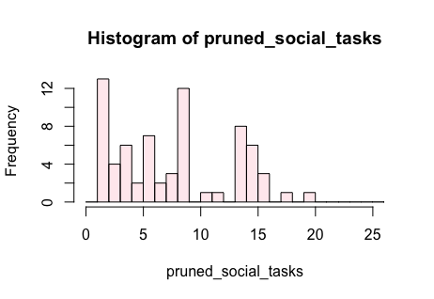
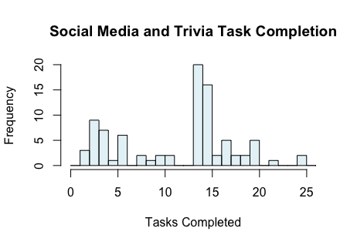
Numerics: Impact of Badges (Fall 2021)
Theory: People will have their motivation refreshed by badges, and thus keep participating after seeing a badge.
Practice: Badges are absorbing (still in seemingly good spots however)
Social Tasks Completed
Trivia Tasks Completed
User Count
User Count
# Tasks Completed
# Tasks Completed
Notes:
ADD SLIDE ABOUT WHAT HAPPENED
Number of users, number of impressions, number of clicks
survey of satisfaction (business reports)
ongoing to be run again

Slide 25
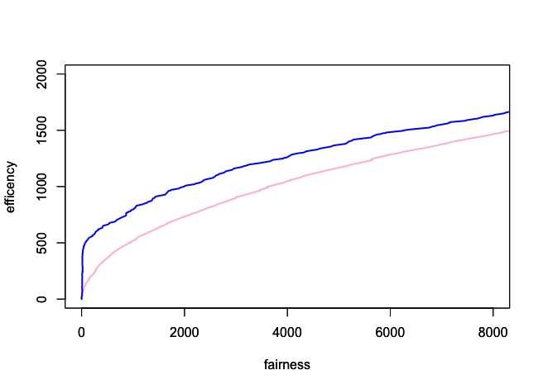
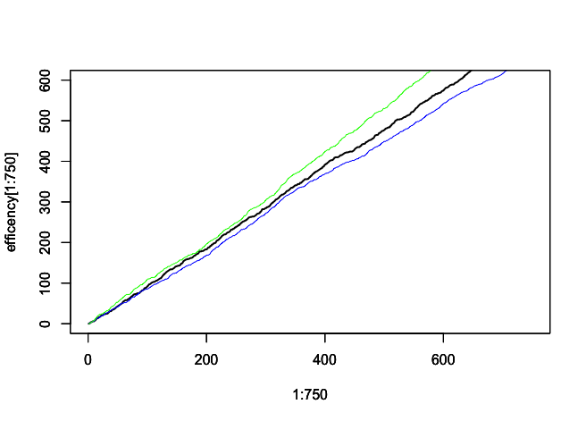
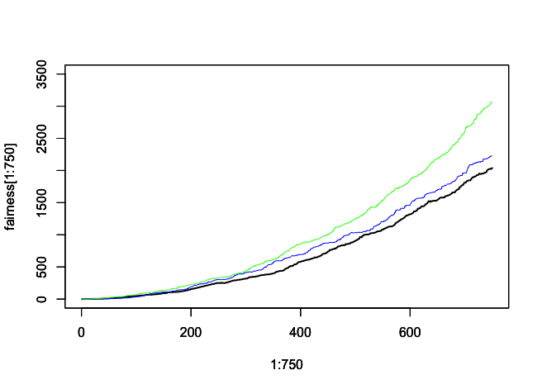
Numerics: Impact of Recommendations (Fall 2021)
2021
BEAUTY | FOOD | ENTERTAINMENT | SHOPPING
0.2580645 | 0.8451613 | 0.5548387 | 0.4516129
% Pref
Social
Trivia
Efficiency (Sum Act.)
Efficiency (Sum Socials)
Fairness (Variance)
User count
User count
Fairness (Variance)
Notes:
ADD SLIDE ABOUT WHAT HAPPENED
Number of users, number of impressions, number of clicks
survey of satisfaction (business reports)
ongoing to be run again

Slide 26
Numerics: Impact of Recommendations (Fall 2021)
2021
BEAUTY | FOOD | ENTERTAINMENT | SHOPPING
0.2580645 | 0.8451613 | 0.5548387 | 0.4516129
% Pref
Only Eff
½ Eff ½ Fair
Efficiency (Sum Socials)
Only Fair
Fairness (Variance)
Efficiency (Sum Socials)
Fairness (Variance)
User count
User count
Notes:
ADD SLIDE ABOUT WHAT HAPPENED
Number of users, number of impressions, number of clicks
survey of satisfaction (business reports)
ongoing to be run again

Slide 27
Numerics: Impact of Recommendations (Fall 2021)
2021
BEAUTY | FOOD | ENTERTAINMENT | SHOPPING
0.2580645 | 0.8451613 | 0.5548387 | 0.4516129
% Pref
Only Eff
½ Eff ½ Fair
Only Fair
Efficiency (Sum Socials)
Efficiency (Sum Socials)
Fairness (Variance)
Fairness (Variance)
User count
User count
Notes:
ADD SLIDE ABOUT WHAT HAPPENED
Number of users, number of impressions, number of clicks
survey of satisfaction (business reports)
ongoing to be run again

Slide 28
Numerics: Impact of Recommendations (Fall 2021)
2021
BEAUTY | FOOD | ENTERTAINMENT | SHOPPING
0.2580645 | 0.8451613 | 0.5548387 | 0.4516129
% Pref
Efficiency (Sum Act)
Efficiency (Sum Socials)
Fairness (Variance)
Fairness (Variance)
User count
User count
Theory: A 50/50 Flip will be a little live somewhere between the purely efficient and purely fair algorithms
Practice: A little less efficient, but basically as fair as the fully fair algorithm!
Notes:
ADD SLIDE ABOUT WHAT HAPPENED
Number of users, number of impressions, number of clicks
survey of satisfaction (business reports)
ongoing to be run again

Slide 29
Conclusions and Future Plans
We build a platform to bridge gaps between students and local Black owned businesses
We propose a novel model for the linking of university students to local Black-owned
We design an incentive system and recommendation system to power the site
We describe simple approaches to badge design and content recommendation that are tailored to our application.
We looked back in data at how the site performed
Some things seem to work well. Badges don’t work as we expected but end up in the right place?
Future Plans
412 Connect Platform is being open-sourced to be re-purposed as an activity for other student groups to run.
CUNY students are planning to run a version in the Fall
Hopefully, many more
Finally submit the journal version
Notes:
So, using the curator model, we recruited Black-owned businesses, and we actually just finished up our first launch!
We ran for a month from around the start of the fall semester to a couple of weeks ago
We had 8 participating businesses, and 139 students using our platform
And now, we’re at a stage where we’re going to look at the data we collected, start to understand how students are actually using our platform and ask ourselves:
Do we need to update our badge model?
Is there an implementable display algorithm which will provide a more equal distribution of actual business engagement?
We also don’t want this to just be for University of Pittsburgh students, we are in the process of recruiting and engaging with other schools in Pittsburgh
And we’re planning to launch again in February of 2022!

Slide 30
Thank You!
This work would not have been possible without the efforts of our community collaborators including Alex Jackson at the Pittsburgh Hub of Data for Black Lives and the following people:
I Younan An, Mara McCloud, Ivy Bryony Chang, Tyler Olin, Claire Guth, Collin Griffin, Miguelina Javier, Diane Roth Cohen, Sonya Akhgar, Sarah Downing, Chloe Harvey, Caelan Schick, Vannie Wang, Falon Weidman, Jeremy Olin, Andi Halim, Gurmail Mathon, Kevin DeMaoiribus, Melanie Cooray, Angel Christou, Kayla Pierre, Uchenna Mbawuike, David Walker, Bob Gradeck, Rob Racuna, and Jennifer Tseng
Come join us at Grief to Action!
Email: caasi@pitt.edu
Twitter: @CAASIPitt
Questions?
Email: mih140@pitt.edu
Website: mhamilton-pitt.github.io
Funding Sources: CAASI Startup Funding and University of Pittsburgh Engaged Scholarship Development Initiative
Notes:
Thank you so much for letting me talk to you about 412Connect and the type of work we are trying to do at Grief to Action
I just want to reiterate how much the success of this project has relied on the efforts and invaluable input of a huge group of people coming from all different backgrounds
If you’re interested and you want to join us, please don’t hesitate to reach out – whatever your skill set, there is a place for you, and we look forward to seeing you soon!

